Slide 1

NBA Finals Playoff Bracket
Brian Brungardt
Liam Crawley
Nathan Fraser
Jack Hill
Christopher Hyland
Taylor Neal
Andy Wang

Slide 2
Purpose
A model is being created to generate a predicted winner along with a complete bracket prediction for the 2022 NBA Finals.
A Monte Carlo simulation is also performed with an iteration of 1000 times to predict how many games out of 1000 times a team will win the tournament.

Slide 3
Methods
We are using public data from sportsreference.com by aggregating the data into a database using SQL and GCP.
A probit model is then constructed and trained on the newly created database, forming winning probabilities for each matchup of teams.
A probit model is used because score differentials tend to follow a normal distribution pattern, giving us the best chance of having accurate predictions.

Slide 4
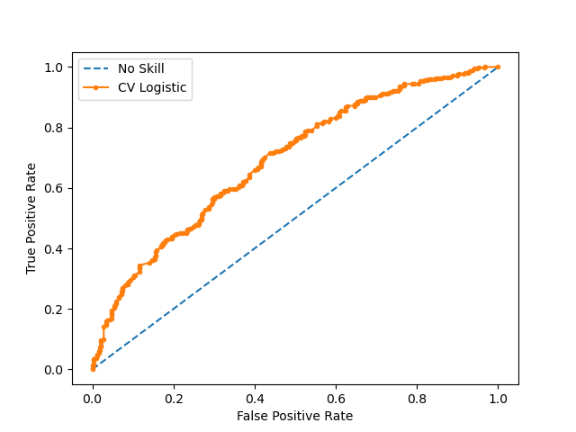
Machine Learning Model

